Slide 1

Downtown Troy
By: RTAN

Slide 2

Hello! We’re...
RTAN which stands for Rensselaer Team of Awesome Networkers

Slide 3
Agenda
What is Downtown Troy?
Summary of the technologies implemented
Project Schedule
Demo of our website

Slide 4
So what is the Downtown Troy Website?
01
Our website includes many restaurants downtown and upcoming events catered to the Troy community and RPI students!

Slide 5
Summary of the Technologies
What we have used so far
What we plan to use
HTML5/CSS/JS
Most work up to now was on the front end.
Used JSONs to model the information that the Restaurants would have
PHP/MySQL
Backend work almost exclusively
This will help with user permissions and displaying unique reviews.
Will help with maintenance of events

Slide 6
Future Plan
Oct 15-31
Nov 1-10
Nov 11-20
Nov 27-28
Dec 1-6
Add the database components and work more on styling
Finish any of the database and adding more javascript
Add jquery elements and any more apis such as Troy Weather
Add cool features and make sure the website is uniformly styled
Finishing touches and practice presenting

Slide 7

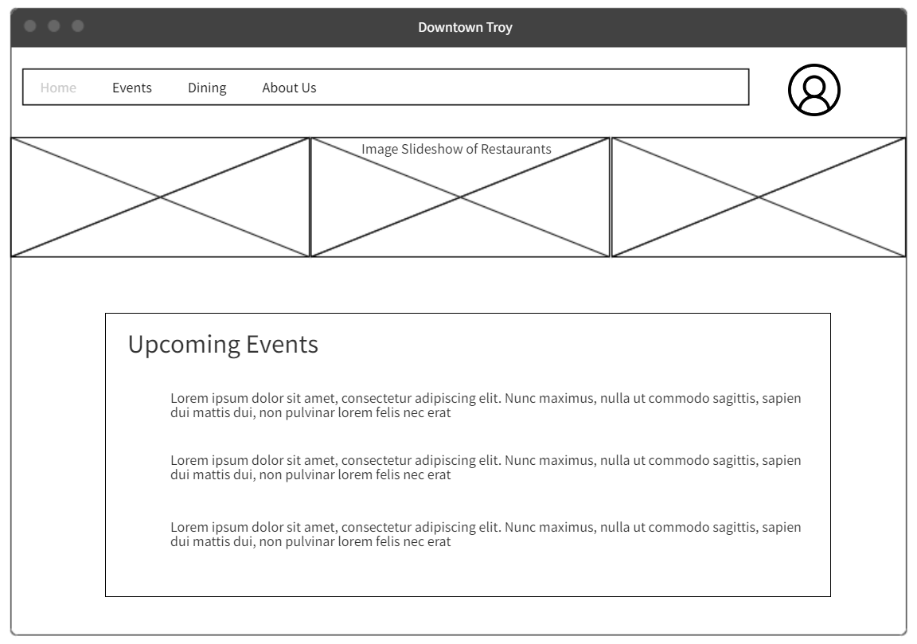
Home Page
We decided not to have as many items on the home page and keep the design more simple including links to all the important aspects of our website.

Slide 8
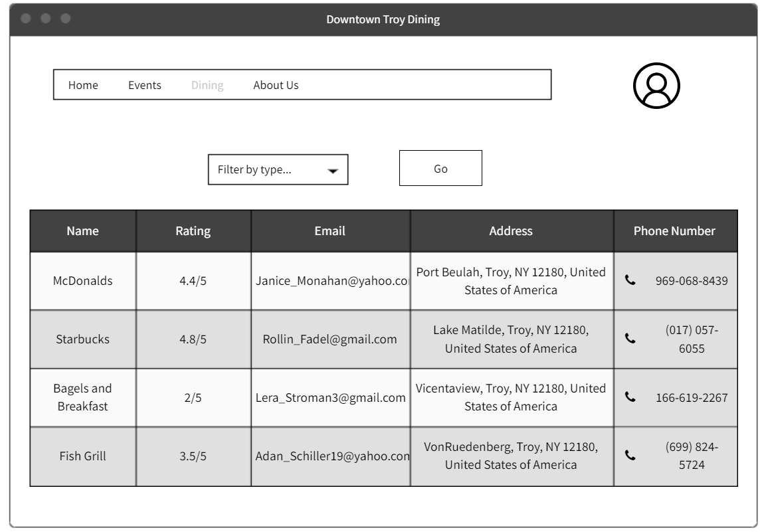
Notes:
Home Page

Slide 9
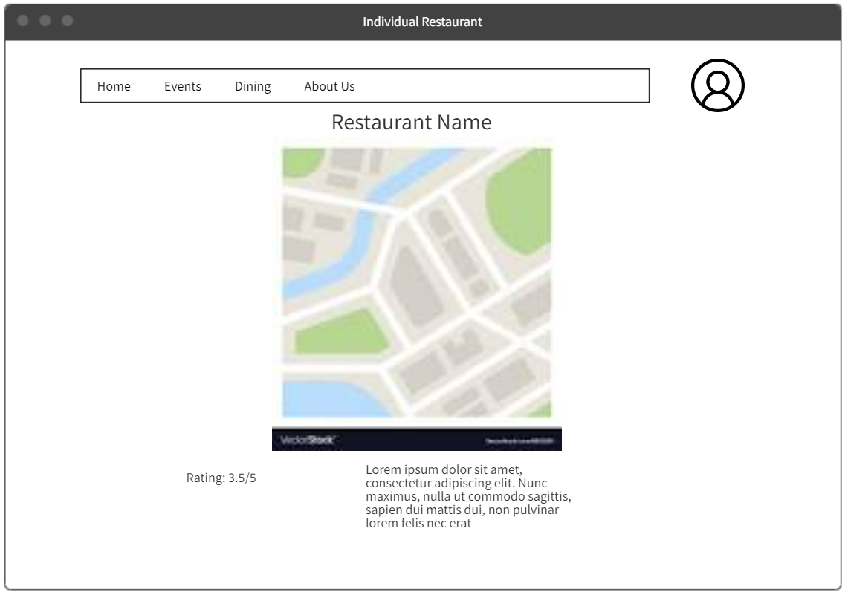
Notes:
Home Page

Slide 10
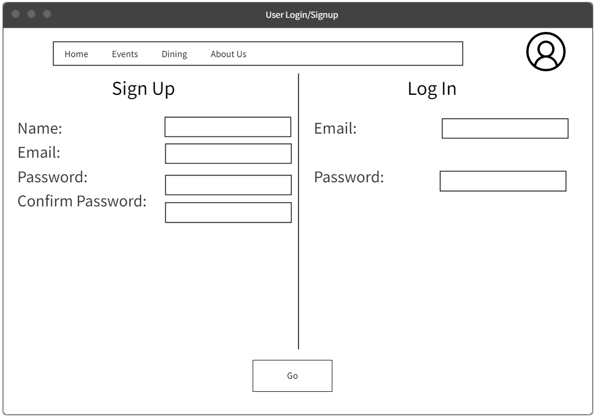
Notes:
Home Page

Slide 11
Thank you!
Do you have any questions?
hello@mail.com
555-111-222
mydomain.com

